Slide 1
Cardiovascular risk computed via Deep Learning (DL) on thoracic CT scans
Timothy Burt, Luben Popov, Yuan Zi
COSC 7373 Adv. Computer Vision F19 Team 1

Slide 2
Project Goal
Design, build, train, and test a deep learning pipeline for feature detection using thoracic CT scans of patients’ hearts
Obtain thoracic CT scans of patients
Design and implement an annotation tool to annotate crop landmarks for the CT scans
Implement a normalization pipeline to normalize the CT scans into 3D arrays
Design and implement a CNN that performs feature selection on the normalized arrays

Slide 3
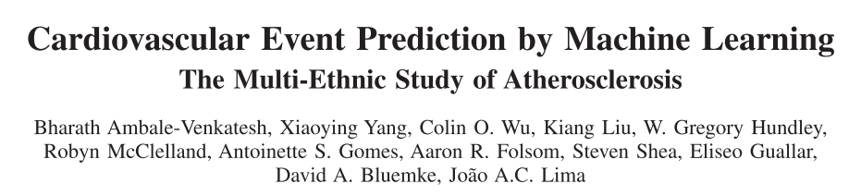
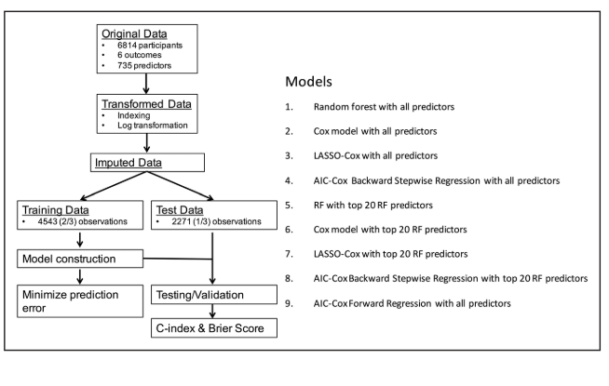
Traditional Machine Learning (ML) paradigms have fruitfully estimated a patient’s chance of survival more accurately than typical risk scores
[1] B. Ambale-Venkatesh et al., “Cardiovascular Event Prediction by Machine Learning,” Circ. Res., vol. 121, no. 9, pp. 1092–1101, Oct. 2017.

Slide 4
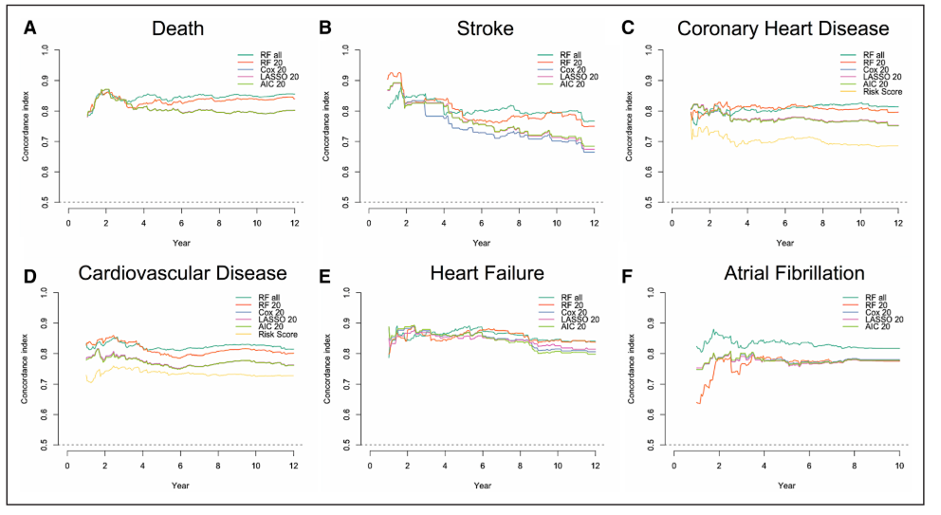
[1] B. Ambale-Venkatesh et al., “Cardiovascular Event Prediction by Machine Learning,” Circ. Res., vol. 121, no. 9, pp. 1092–1101, Oct. 2017.

Slide 5
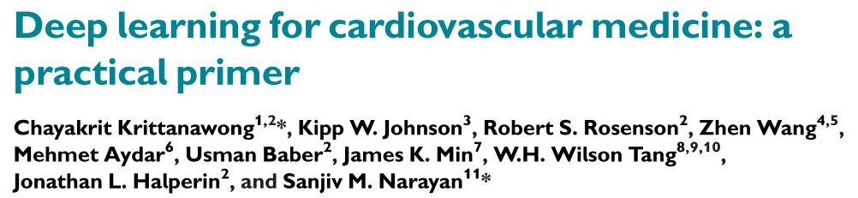
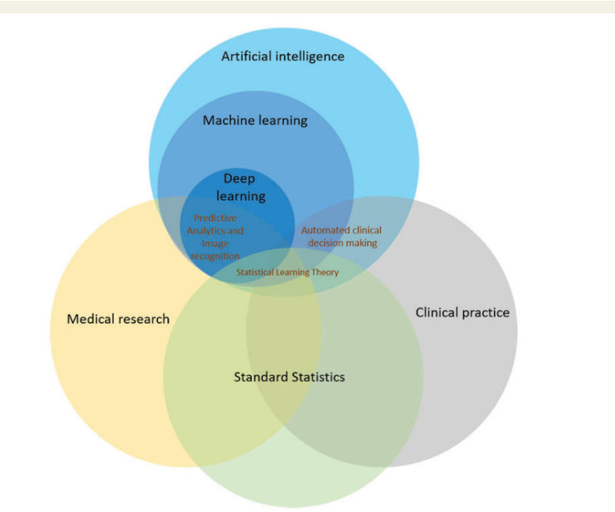
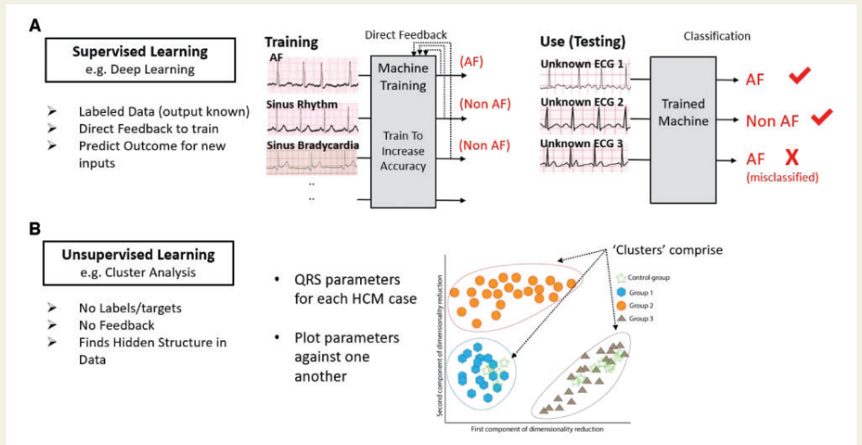
[1] C. Krittanawong et al., “Deep learning for cardiovascular medicine: A practical primer,” Eur. Heart J., vol. 40, no. 25, pp. 2058-2069C, 2019.

Slide 6
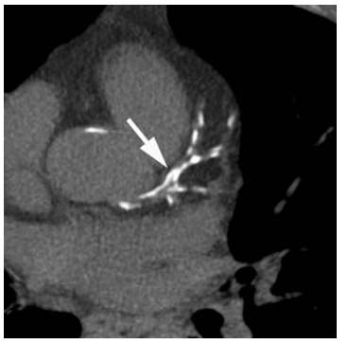
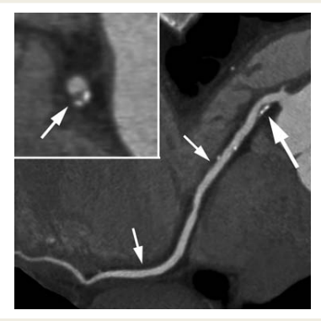
How are Cardiovascular Risk Scores typically computed via imaging data?
By detection and amount of coronary artery calcium (CAC)
Traditional scoring algorithms:
Agatson Score
Volume Score
Mass Score
Patients need to be between 40-~65 YO for CAC to correlate the highest with atherosclerosis
Traditional CT
Gated CT Angiography
[1] S. Achenbach and P. Raggi, “Imaging of coronary atherosclerosis by computed tomography,” Eur. Heart J., vol. 31, no. 12, pp. 1442–1448, 2010.
Notes:
﻿Imaging of coronary calcification by computed tom- ography. In non-enhanced scans, coronary calcium is clearly depicted because of its high computed tomography attenuation. Here, calcium in the left main and left anterior descending coron- ary artery as well as diagonal branches is present (arrow).

Slide 7
Project Data Pipeline
CT Images (DICOM Format)
Retrieve From Public Source
Annotation Files (JSON Format)
Generated Using Annotation Tool
Normalized 3D Arrays (.npy Format)
Generated From Annotation Files + DICOM Files Using Normalization System
3D CNN (Tensorflow)
Trained + Tested Using Normalized 3D Arrays

Slide 8
DICOM Format
DICOM stands for Digital Imaging and Communications in Medicine
Standardized format for medical imaging
Stores images using scalar data; values correspond to the medical equipment’s measurements for each pixel of the image
This means the pixel data needs to be manually normalized into RGB or grayscale format to be displayed
Also stores attribute data indicating the individual file’s metadata and place in a greater series of files
We only use Patient ID and Slice Location attributes in addition to the pixel array

Slide 9
CT Image Dataset
One series per patient
One series per folder
Variable slices for each patient
Axial slices (each slice is on the xy axis, slices are usually ordered top-to-bottom)
16 bit pixel values with a minimum padding value of -2048
This value is less than any other value and is used in background space that isn’t actually part of the scan; this is used to convert the elliptical scan to a rectangular image

Slide 10
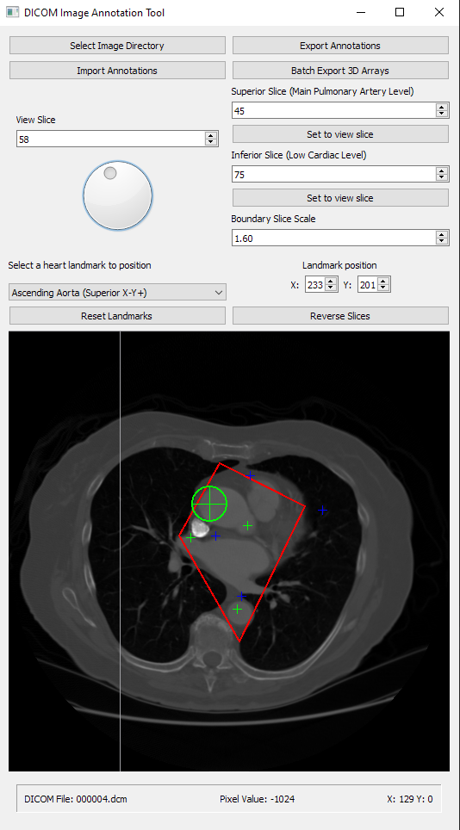
Annotation Tool: Goals
Allow user to import a folder of DICOM (.dcm) files and view its contents as a cross sectional image
Allow user to mark eight key landmarks on two key slices of the cross sectional image (four landmarks per slice) and export the landmarks as an annotation so that the CT images can be cropped and normalized using that data
Minimize the time it takes the user to annotate each cross sectional image by providing an intuitive UI

Slide 11
Annotation Tool: Reading DICOM Files
We read DICOM files using the Pydicom library
Automatically reads pixel array data into a scalar value
Provides a convenient interface to read attribute data
Scan directory for DICOM files, create array of Pydicom objects for files with slice location values, sort by slice location values
Slice location values represent the position of the cross sectional image slice represented by the DICOM file in millimeters; using this as the sorting value guarantees that the slices will be in the correct order [1]
[1] Innolitics, “Slice Location Attribute – DICOM Standard Browser.” [Online]. Available: https://dicom.innolitics.com/ciods/ct-image/image-plane/00201041. [Accessed: 04-Dec-2019].

Slide 12
Annotation Tool: DICOM File Edge Cases
Assumptions: user has only placed DICOM files of the same series within the folder they are trying to open
Many DICOM viewing programs as well as the Pydicom sample code do this; it’s safe to assume user is smart enough to not mix their data
Error handling: cancel and open an error popup if user selects a folder with less than two DICOM files with slice location attributes
Ignore DICOM files that begin with a “.”
Our data had extra files with a “.” prefix and they crashed any DICOM reader we opened them with
Ignore DICOM files with no slice location attribute

Slide 13
Annotation Tool: Displaying CT Images
To display CT images in the annotation tool, the scalar values need to be converted to grayscale 8 bit color space (0-255)
Simply normalizing from the minimum scalar value in the cross sectional image to the maximum value causes a dull, gray image due to the padding value used for the background, which is much lower than any other pixel value
Thus, the final method for displaying the images takes the second lowest pixel value in the entire cross sectional image and uses that as the minimum for normalization, adding more visible detail to the preview image

Slide 14
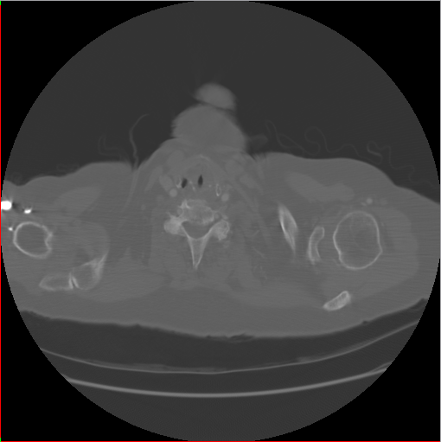
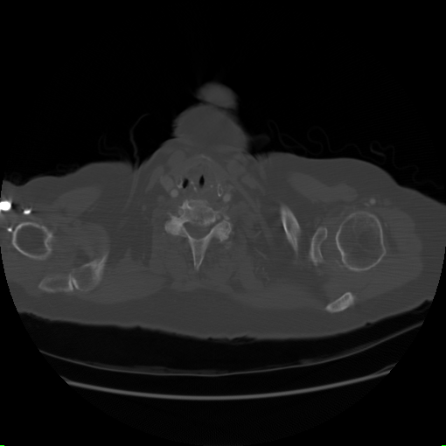
Annotation Tool: Displaying CT Images
Basic min-max normalization
Second min-max normalization

Slide 15
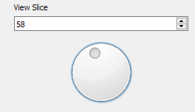
Annotation Tool: Navigating Cross Sectional Image
Providing the user with multiple ways to navigate the cross sectional image improves productivity and lets them tailor their workflow to their preferences
4 Ways To Navigate:
Directly modify value in view slice adjustment widget
Use spin box buttons next to the value in view slice adjustment widget
Use dial in view slice adjustment widget (coarse adjustment)
User can scroll while their mouse is over the view slice image itself

Slide 16
Annotation Tool: Heart Landmarks
User needs to mark find two boundary slices in the cross sectional image and mark four landmarks on each boundary slice
Superior (top) slice should be around the main pulmonary artery level
User needs to mark the ascending aorta, pulmonary trunk, ascending aorta, and superior vena cava
Inferior slice (bottom) should be around the low cardiac level
User needs to mark the right ventricle, left ventricle, descending aorta, and inferior vena cava

Slide 17
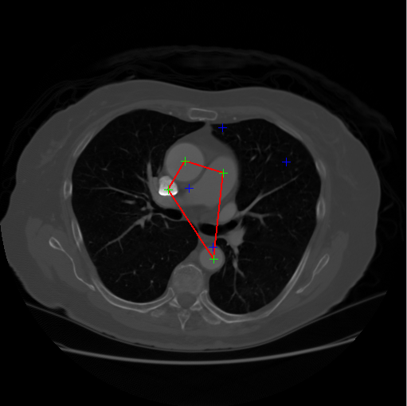
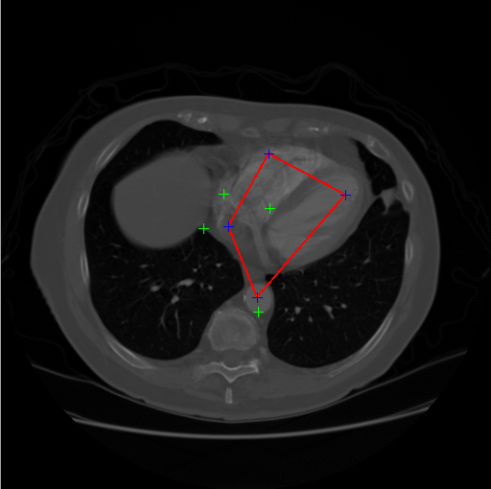
Annotation Tool: Heart Landmarks
Right Ventricle
Ascending Aorta
Pulmonary Trunk
Left Ventricle
Superior Vena Cava
Inferior Vena Cava
Descending Aorta
Descending Aorta
Superior Slice
Inferior Slice

Slide 18
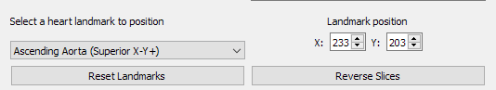
Annotation Tool: Marking Heart Landmarks
Landmarks default to four corners of image at top and bottom slices
User selects heart landmark from drop down menu
Landmark can be placed by clicking on the view slice or by adjusting the XY coordinates using the landmark position spin boxes
User can also reset the landmarks to their default position, or reverse the order of the slices in the cross sectional image in case the DICOM slice positions were reversed

Slide 19
Annotation Tool: Boundary Slice Scaling
When marking landmarks inside of the actual heart landmarks, this creates crop boundaries that are too narrow; major arteries that can contain valuable data are missed
Thus, a user option to scale the superior and inferior crop bounds was added (with the center of the crop bounds used as the center of scaling)
While this allows us to include all arteries in the heart, it also causes unwanted lung data to be shown (a polygon crop is needed to get the “best of both worlds”)

Slide 20
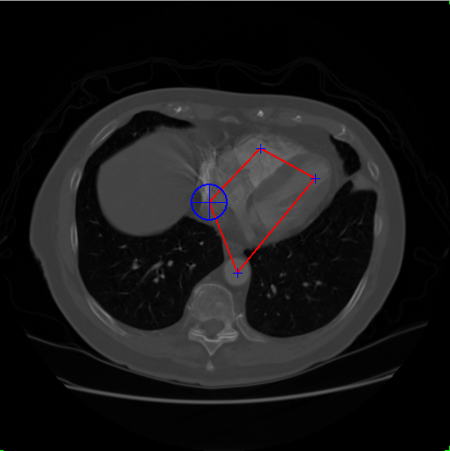
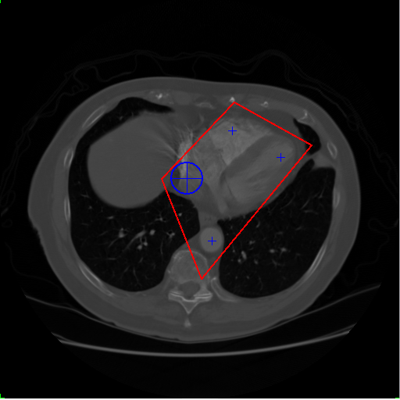
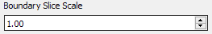
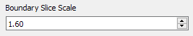
Annotation Tool: Boundary Slice Scaling

Slide 21
Annotation Tool: Boundary Slice Interpolation
We need to interpolate between the crop boundaries for the superior and inferior slice to get the crop boundaries for all the slices in between
This is done with basic linear interpolation and is shown in the annotation tool
Since 3d normalization is now integrated into the annotation tool, this is also used for normalizing the annotated CT images

Slide 22
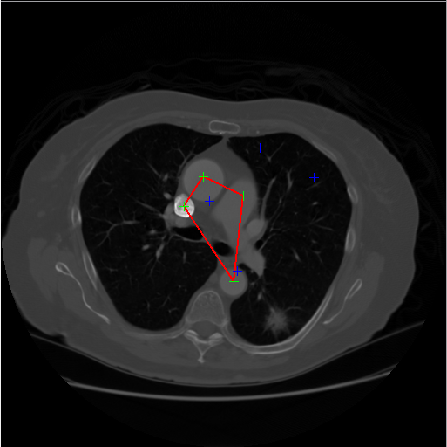
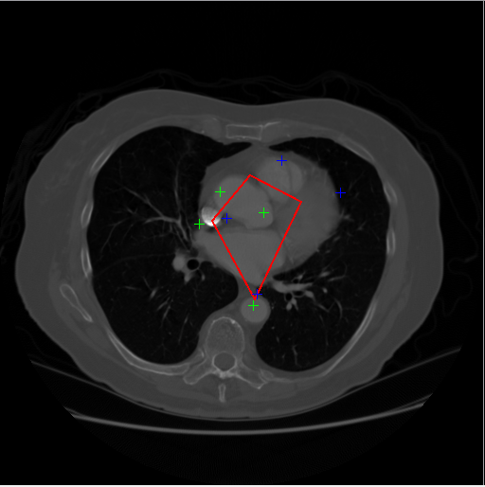
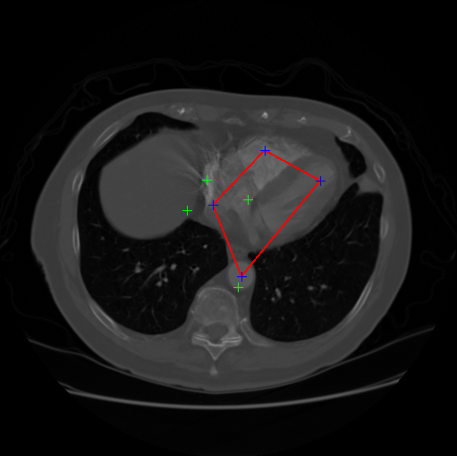
Annotation Tool: Boundary Slice Interpolation
Unscaled Boundaries at Superior Slice 45
Unscaled Boundaries at Intermediate Slice 60
Unscaled Boundaries at Inferior Slice 75

Slide 23
Annotation Tool: Annotation Files
The exported annotation files for a cross sectional image are in JSON format, but stored with a .annotation extension to make them easily distinguishable from non-annotation JSON files
The annotation files store the absolute path to the CT image directory (and thus are only usable on a machine where the CT image files are in that path), as well as the boundary slices, landmarks, and boundary scale factor
Annotation file names are always suffixed with the patient ID to make it easy to find the right annotation file for a specific patient

Slide 24
Annotation Tool: Annotation Files
The original annotation files had boundary points for every slice within the crop boundaries
When cropping and normalization was integrated into the annotation tool, this was no longer necessary, as the tool’s libraries could do boundary interpolation and scaling automatically
This drastically reduced the size of the annotation files

Slide 25
Annotation Tool: UI Design
Used PyQt 5 for UI programming
Tool was iterated upon several times to provide multiple options for workflow and minimize annotation time
Regular testing done with the whole team to figure out what features needed to be added

Slide 26
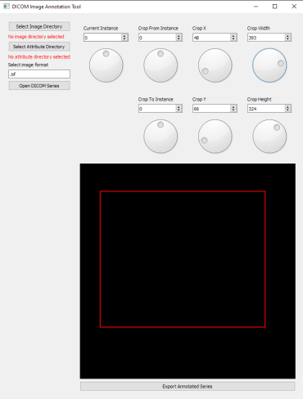
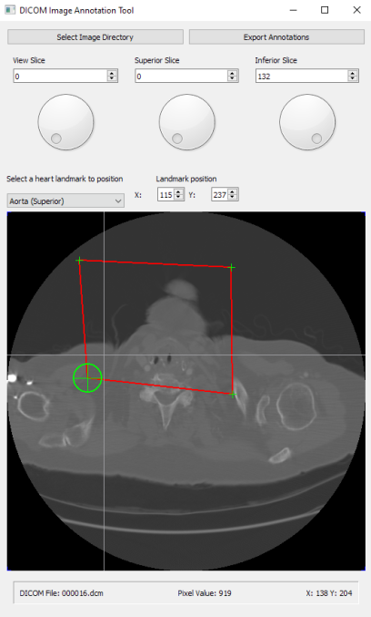
Annotation Tool: UI Design Iteration

Slide 27
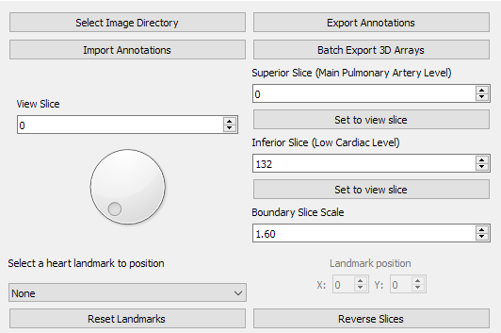
Annotation Tool: UI Elements
Select Image Directory Button
Export Annotations Button
Import Annotations Button
Batch Normalization Button
View Slice Viewer/Adjuster
Superior Slice Viewer/Adjuster
Inferior Slice Viewer/Adjuster
Boundary Slice Scale Viewer/Adjuster
Heart Landmark Selector
Landmark Position Viewer/Adjuster
Reset Landmarks Button
Reverse Slices Button
1
2
3
4
6
5
7
8
9
10
11
12

Slide 28
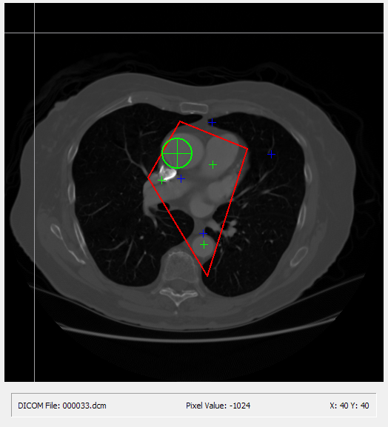
Annotation Tool: UI Elements
1. View Slice Target Cursor
2. View Slice Crop Boundaries (disappears when view slice is out of slice bounds)
3. Landmark Marker (green = superior, blue = inferior)
4. Currently Selected Landmark Marker
5. View Slice File Name
6. View Slice Target Pixel Value (original scalar value)
7. View Slice Target Pixel Position
1
4
3
2
5
6
7

Slide 29
Annotation Tool: Effectiveness and Future Improvements
Current annotation tool allows trained user to annotate an image in less than a minute without caring too much about landmark placement, roughly two minutes with more deliberate placement
Less than half of what it was in an earlier iteration
Annotation files are very compact; only 702 bytes each
In the future, tooltips and a more compact tool section could make the tool even more intuitive

Slide 30
Cropping and Normalization: Goals
CT images need to be cropped using the boundaries given by the annotation files, combined into a 3D matrix representing the entire cross-sectional image, and then rescaled into a standard size for the CNN (256x256x256)
Units for CT images need to be converted to Hounsfeld Units (HU)
Annotation files must be exported in NumPy binary (.npy) format
Normalization should be integrated into the annotation tool; the user can immediately click the "Batch Export 3D Arrays" button after annotating, select a folder with annotation files, and let the annotation tool generate the 3D arrays
Minimize normalization time and allow user to normalize many annotations in a batch instead of one by one

Slide 31
Cropping and Normalization: Basics
Only looks at slices starting at the superior slice and ending at the inferior slice defined in user annotations
Uses annotation tool libraries to determine interpolated crop bounds for each slice
Black space (space outside the crop area) is minimized by taking overall XY boundaries of landmarks
Slices are combined into a single 3D NumPy array
3D NumPy array is resized (using bilinear filtering) into 256x256x256 size
Bilinear filtering is done for individual slice resizing using OpenCV 2’s resize function, and for resizing the Z axis using SciPy’s zoom function

Slide 32
Cropping and Normalization: Hounsfield Units
Hounsfield units are a standardized relative quantitative measurement of radio density of CT images [1]
We need to convert DICOM pixel array scalar values to HUs for normalization
First set all padding values to 0
For each scalar value, multiply by the rescale slope for the CT image, then add the intercept value for the CT image
Rescale slope and intercept are part of DICOM attribute data and can be retrieved using Pydicom
[1] T. D. DenOtter and J. Schubert, Hounsfield Unit. StatPearls Publishing, 2019.

Slide 33
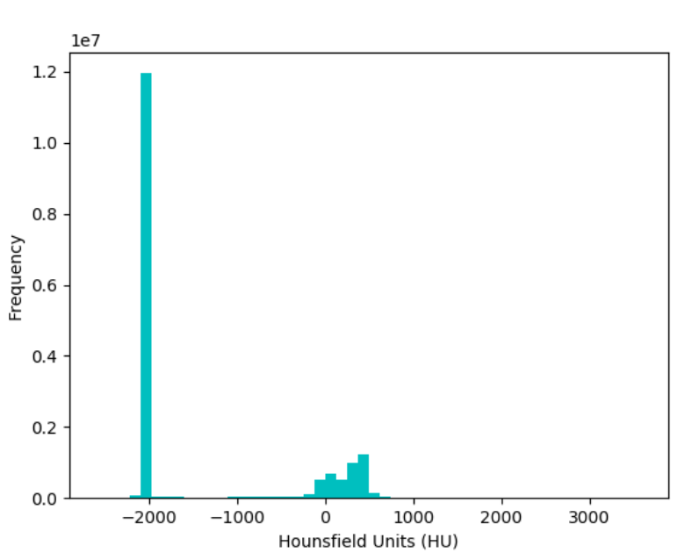
Cropping and Normalization: Sample HU Value Distribution for Patient

Slide 34
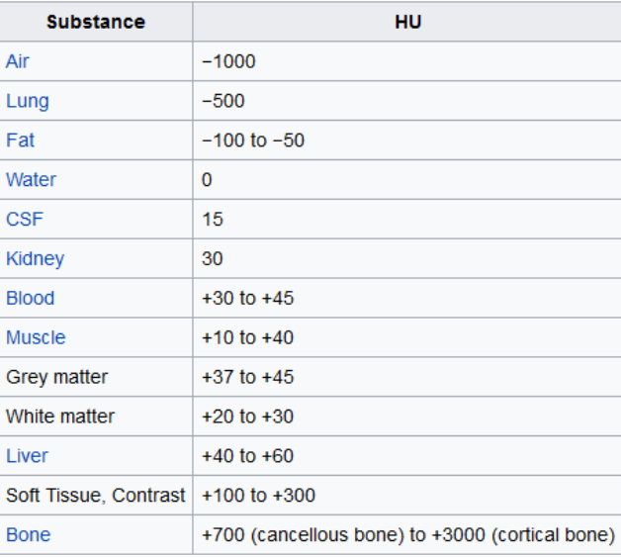
Cropping and Normalization: Hounsfield Units Table

Slide 35
Cropping and Normalization: Projection vs. Affine Normalization
Two different kinds of normalization were implemented, as each has strengths and weaknesses
Affine: simply crop out the boundary section for each slice, while cropping the overall edges of the image to minimize black space
Pros: preserves affine properties of features (parallel lines remain parallel, etc), allows for processing after normalizing z axis of 3D array, resulting in nearly constant run time regardless of slice count
Cons: introduces a significant amount of black space even after cropping out excess black space
Projection: project the portion of each slice inside the crop boundaries onto a normalized rectangle (using scikit image ProjectiveTransform), sample each rectangle pixel from the crop area using bilinear sampling
Pros: completely minimizes black space and accounts for rotational differences between hearts
Cons: deforms the image significantly if crop boundaries aren't rectangular in shape, variable run time based on number of cross sectional slices

Slide 36
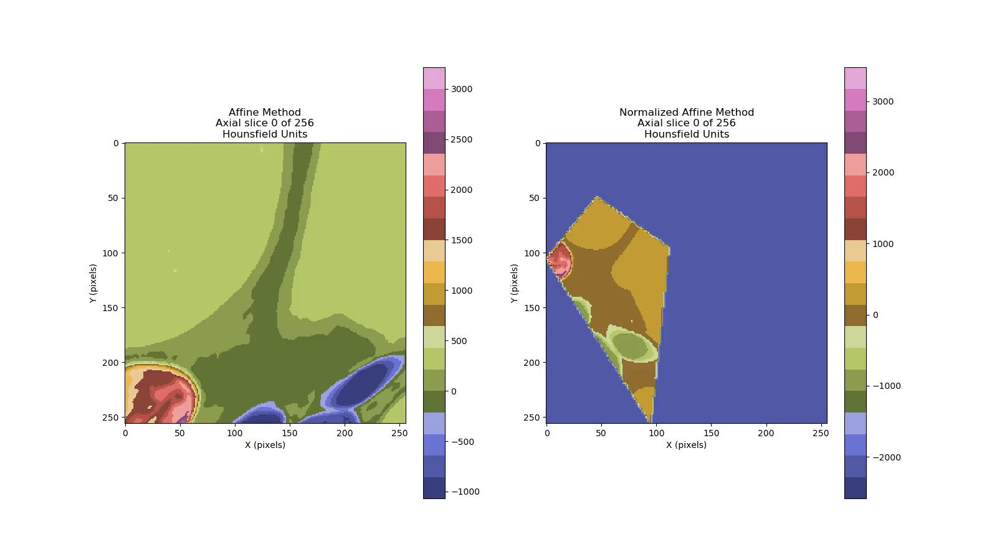
Cropping and Normalization: Projection vs. Affine Cropping (20 quantitative bins colormap)

Slide 37
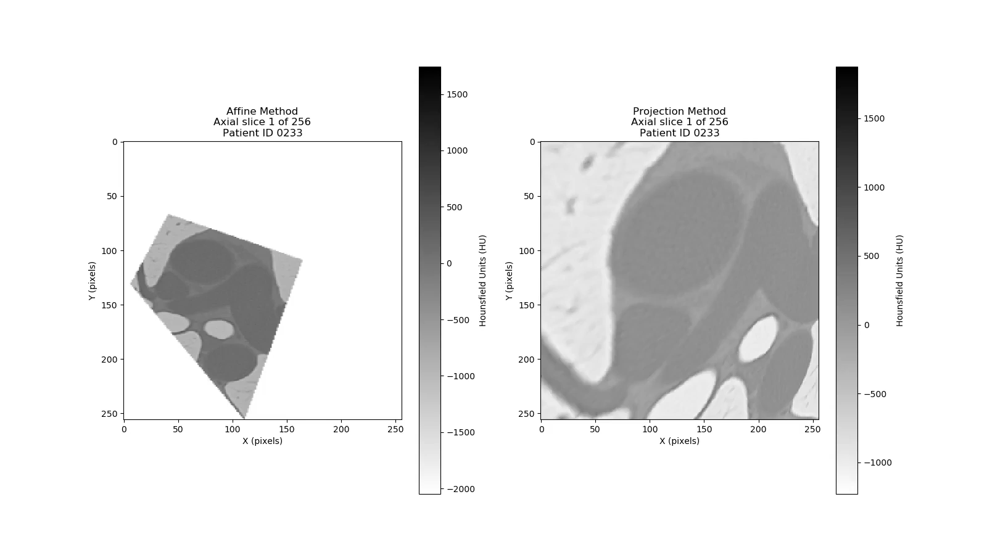
Cropping and Normalization: Projection vs. Affine Cropping (binary colormap)

Slide 38
Cropping and Normalization: UI
Integrated with annotation tool
User just must click “Batch Export 3D Arrays”, select a directory with annotations, and the annotation tool will start normalizing and exporting a 3D array for every annotation file in that directory
Generates one affine normalized array and one projection normalized array for each annotation file
Exported arrays are placed in same directory as annotation files
Like annotation files, exported arrays are prefixed with patient ID for convenience

Slide 39
Cropping and Normalization: Effectiveness
Affine normalization takes ~24.5 seconds to process a single array
Not variable based on number of crop slices
Projection normalization takes ~251.0 seconds to process a single array from 94 slices
Projection normalization runtime is dependent on number of crop slices
Much slower than affine normalization
Since user processes multiple annotations in a batch, leaving a bunch of annotations “in the oven” after manually annotating multiple CT images is relatively painless
Big improvement over earlier versions which required manually running normalization for each annotation or automatically normalizing instead of exporting annotation files

Slide 40
LIDC-IDRI Dataset
1,017 thoracic CT scans
Subset of 157 patients have diagnosis data
DISEASE CLASS, we’ve annotated all these
4 classes:
Unknown (27)
benign or non-malignant disease (36)
malignant, primary lung cancer (43)
malignant metastatic (51)

Slide 41
3D CNN: Train/Test Validation Method
80/20 train/test split
random shuffle, within each of the 4 classes (NOT latent, probabilities)
Question: how will these lung disease classifiers help with the detection of CAC in the heart?
 | Total | Train | Test
 |  | 0.8 | 0.2
Unknown | 27 | 21 | 6
Benign | 36 | 28 | 8
Malignant, primary lung cancer | 43 | 34 | 9
Malignant metastatic | 51 | 40 | 11
Total | 157 | 123 | 34

Slide 42

3D CNN: Method Feasibility
Many of the patient’s scans had noticeable CAC present
Usually “ground truths” are little snapshot images fed in the CNN to detect a feature
Next, I will show how we are implementing this in TensorFlow
[1] https://www.health.harvard.edu/heart-health/when-you-look-for-cancer-you-might-find-heart-disease

Slide 43
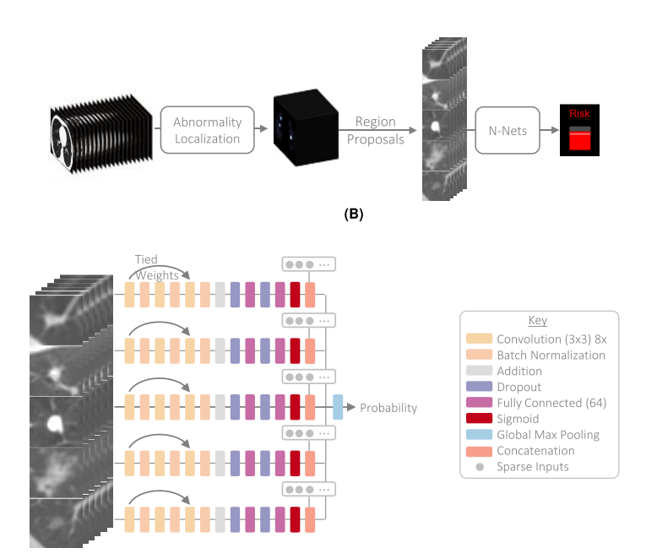
3D CNN: Ontology and ‘ResNets’
Obtain snapshots via ”erosion & dilation” to remove lung crops and nodules
k-means clustering (k=2 or 3) and cluster bounding region defined by first conv. kernel size [3X3]
Annotate undiagnosed class to 50/50 of our 157 DISEASED class (314 UNDISEASED annotations need to be done to fully remove bias)
[1] S. Trajanovski et al., “Towards radiologist-level cancer risk assessment in CT lung screening using deep learning,” pp. 1–11, 2018.

Slide 44
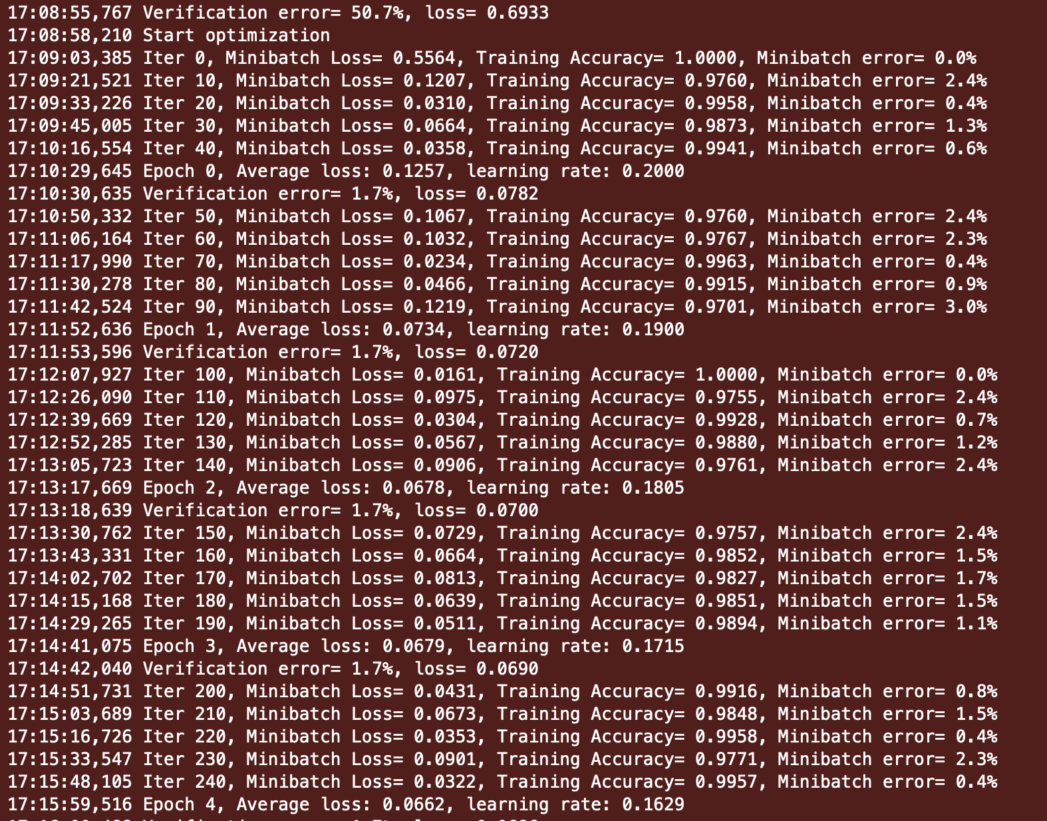
3D CNN: Training on 2019 iMac
Too slow!
Move on Sabine
Apply fixes to open answer questions, in next slide

Slide 45
3D CNN: Open questions
Our model does not converge over 10 epochs currently
To complete a publication-grade study, we need to:
Run standard CAC risk score algorithms, including patient age, race, etc., and apply an Agatson risk score
Run our ResNet 3D CNN architecture with proper “ground truth” images of CAC in arteries
Ensure overbalancing is corrected to 50/50 by arguing the strong correlation of lung/heart diseases and CAC present makes them part of the higher risk class
Apply a similarity score to measure the accuracy of a deep learning CAC risk score with both rule-based CAC (counting pixels matching criterion) and ML-based CAC (ML on the MESA dataset we first showed)
We will have a plot of Training Loss vs. Epochs in our final submission

Slide 46
Demo Time/Q&A Thank You!

